Slide 1
Big Data

Slide 2
What is Big Data?
How big is Big?
Constantly moving target
More than 100 petabytes in 2012
Notes:
Big Data is large in quantity, is captured at a rapid rate, and is structured or unstructured, or some combination of the above. These factors make Big Data difficult to capture, mine, and manage using traditional methods. There is so much hype in this space that there could be an extended debate just about the definition of big data.
Using Big Data technology is not restricted to large volumes. The examples in this article use small samples to illustrate the capabilities of the technology. As of the year 2012, clusters that are big are in the 100 Petabyte range.
Big Data can be both structured and unstructured. Traditional relational databases, like Informix and DB2, provide proven solutions for structured data. Via extensibility they also manage unstructured data. The Hadoop technology brings new and more accessible programming techniques for working on massive data stores with both structured and unstructured data

Slide 3
Big in What?
Big in Volume
Big in Velocity
Big in Variety

Slide 4
Big Data Dimensions

Slide 5
Big Data Dimensions – add more Vs

Slide 6
Goal of Big Data
Good data management
Integrated with complex analytics

Slide 7
Will now talk about
Hadoop

Slide 8
Hadoop

Slide 9
What is Hadoop?
For the executives:
Hadoop is an Apache open source software project
Gives you value from the volume/velocity/variety of data you have
Legal
An open source suite of software that is packaged and supported by multiple suppliers.
licensed under the Apache v2 license

Slide 10
Hadoop components
HDFS
MapReduce
Hadoop Streaming
Hive and Hue
Pig
Sqoop
Hbase
FlumeNG
Whirr
Mahout
Fuse
Zookeeper

Slide 11
What are the components of Hadoop?
Two core components,
File store called Hadoop Distributed File System (HDFS)
Programming framework called MapReduce

Slide 12
HDFS

Slide 13
HDFS:Stands for Hadoop Distributed File system.
HDFS: Through hdfs we can store large amount of data.
The Datanodes store your data, and the Namenode keeps track of where stuff is stored.

Slide 14
Namenode:
Master daemon
Maintain and manages datanodes.
Record metadata. E.g location of block stored,the size of the files,permissions,hierarchy,etc.
Receive heartbeat(it means which datanode is alive) and block report from all datanodes.

Slide 15
Datanode:
Slave daemons
Store actual data
Serves read and write request from the clients.

Slide 16

Notes:
The NameNode and DataNode are pieces of software designed to run on commodity machines. These machines typically run a GNU/Linux operating system (OS). HDFS is built using the Java language; any machine that supports Java can run the NameNode or the DataNode software. Usage of the highly portable Java language means that HDFS can be deployed on a wide range of machines. A typical deployment has a dedicated machine that runs only the NameNode software. Each of the other machines in the cluster runs one instance of the DataNode software. The architecture does not preclude running multiple DataNodes on the same machine but in a real deployment that is rarely the case.
The existence of a single NameNode in a cluster greatly simplifies the architecture of the system. The NameNode is the arbitrator and repository for all HDFS metadata. The system is designed in such a way that user data never flows through the NameNode.
The NameNode machine is a single point of failure for an HDFS cluster. If the NameNode machine fails, manual intervention is necessary. Currently, automatic restart and failover of the NameNode software to another machine is not supported.

Slide 17
Map reduce

Slide 18
Map Reduce
MapReduce is a programming model suitable for processing of huge data.

Slide 19
Map - Reduce
Iterate over a large number of records
Map: extract something of interest from each
Shuffle and sort intermediate results
Reduce: aggregate intermediate results
Generate final output

Slide 20
MapReduce Programming Model
Input: a set of key/value pairs
User supplies two functions:
map(k,v) → list(k1,v1)
reduce(k1, list(v1)) → v2
(k1,v1) is an intermediate key/value pair
Output is the set of (k1,v2) pairs
Notes:
20

Slide 21
…
How MapReduce works
Lets understand this with an example –
Consider you have following input data for your MapReduce Program
Welcome to Hadoop Class
Hadoop is good
Hadoop is bad
Adapted from Jeff Ullman’s course slides

Slide 22
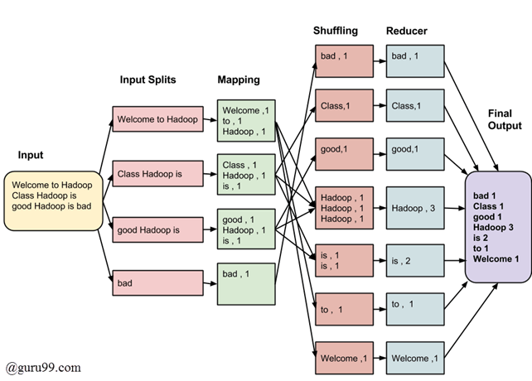
MapReduce: Execution overview
Notes:
22

Slide 23
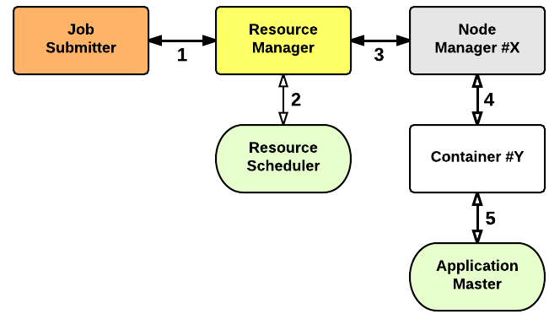
YARN

Slide 24
In YARN, there are at least three actors:
the Job Submitter (the client)
the Resource Manager (the master)
the Node Manager (the slave)

Slide 25
The application startup process is the following:
a client submits an application to the Resource Manager
the Resource Manager allocates a container
the Resource Manager contacts the related Node Manager
the Node Manager launches the container
the Container executes the Application Master

Slide 26
Hive
Hive is a data warehouse infrastructure tool to process structured data in Hadoop.
It is a platform used to develop SQL type script.
Platform used to develop SQL type scripts called HiveQL or HQL to do MapReduce operations.
Not a relational database.

Slide 27
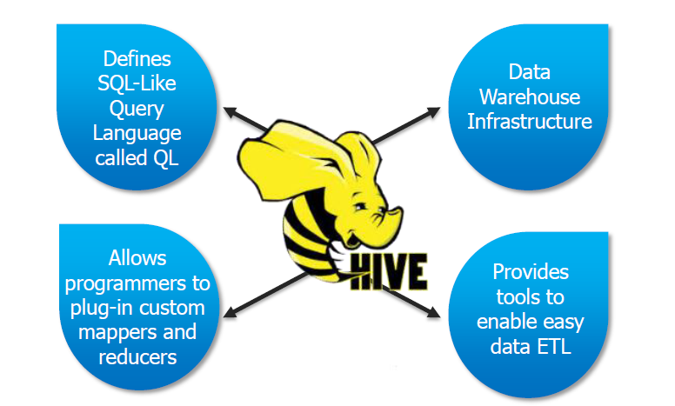

Slide 28
Pig
Pig is a high level data flow platform for executing Map Reduce programs of Hadoop.
It is provided by Apache.
The language for Pig is pig Latin.
Pig Latin is similar to SQL and it is easy to write a Pig script.

Slide 29
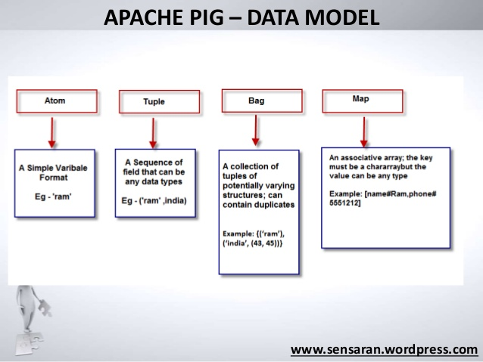

Slide 30
Sqoop
Sqoop is a tool designed to transfer data between Hadoop and relational database servers.
It is used to import data from relational databases such as MySQL, Oracle to Hadoop HDFS, and export from Hadoop file system to relational databases.
Each row in a table is treated as a record in HDFS. All records are stored as text data in text files or as binary data in Avro and Sequence files.
The export tool exports a set of files from HDFS back to an RDBMS.

Slide 31
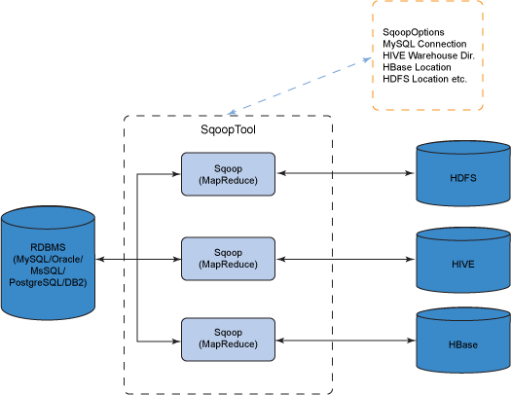

Slide 32
Project H1B case study
The H1B is an employment-based, non-immigrant visa category for temporary foreign workers in the United States. For a foreign national to apply for H1B visa, an US employer must offer a job and petition for H1B visa with the US immigration department. This is the most common visa status applied for and held by international students once they complete college/ higher education (Masters, Ph.D.) and work in a full-time position.

Slide 33
Tools required
Mapreduce
Hive
Pig

Slide 34
Thank you

